Slide 1
Deep Dive into native Universal App development with the Office 365 APIs
Speaker name
Title
Microsoft Corporation

Slide 2

Agenda
Introduction
Overview of Universal Apps
Deep Dive into Universal App projects
Integrating Office 365 APIs

Slide 3
Introduction

Slide 4
Universal Windows Apps
Announced at //build/ 2014
Three major goals
Reach customers across phones, tablets and PCs
Deliver innovation that supports developer investments
Make cross-platform technology easier and more capable
Delivered in Visual Studio 2013 Update 2

Slide 5
Overview of Universal Apps

Slide 6
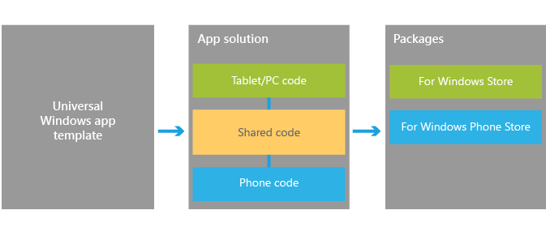
Visual Studio support
Windows App Certification Kit
Project template
Notes:
The Windows App Certification Kit has been extended to Phone apps. This allow a universal app to be in both Stores

Slide 7
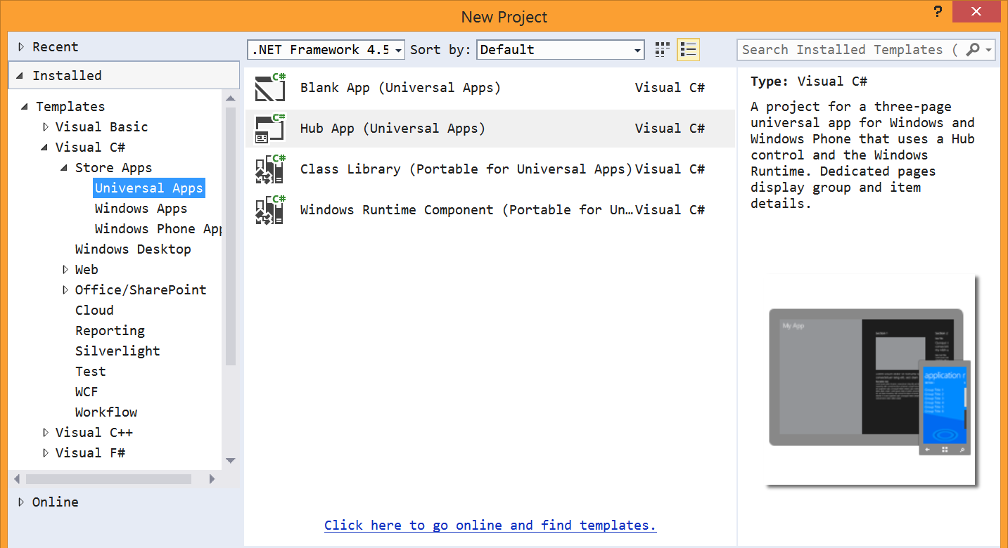
Universal App project template

Slide 8
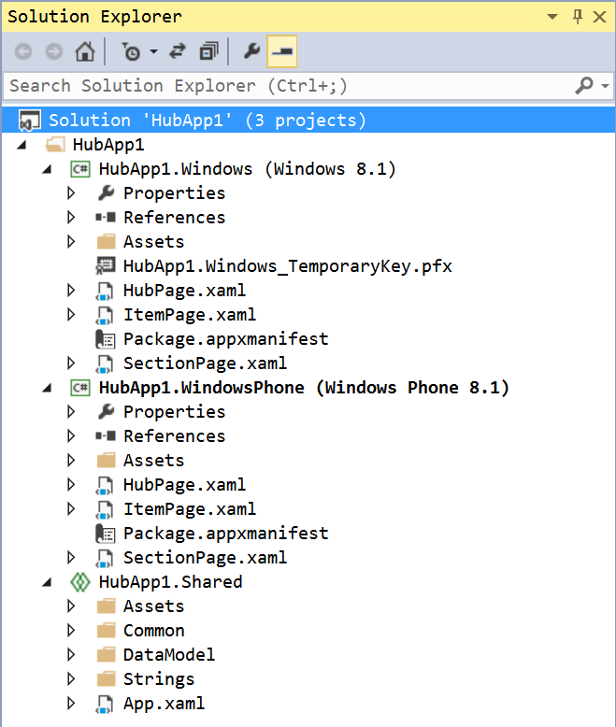
Universal App project template
Solution contains three projects
Windows
Phone
Shared
Shared is a special project type
File type is “shproj”
Does not contain references
Does not build

Slide 9
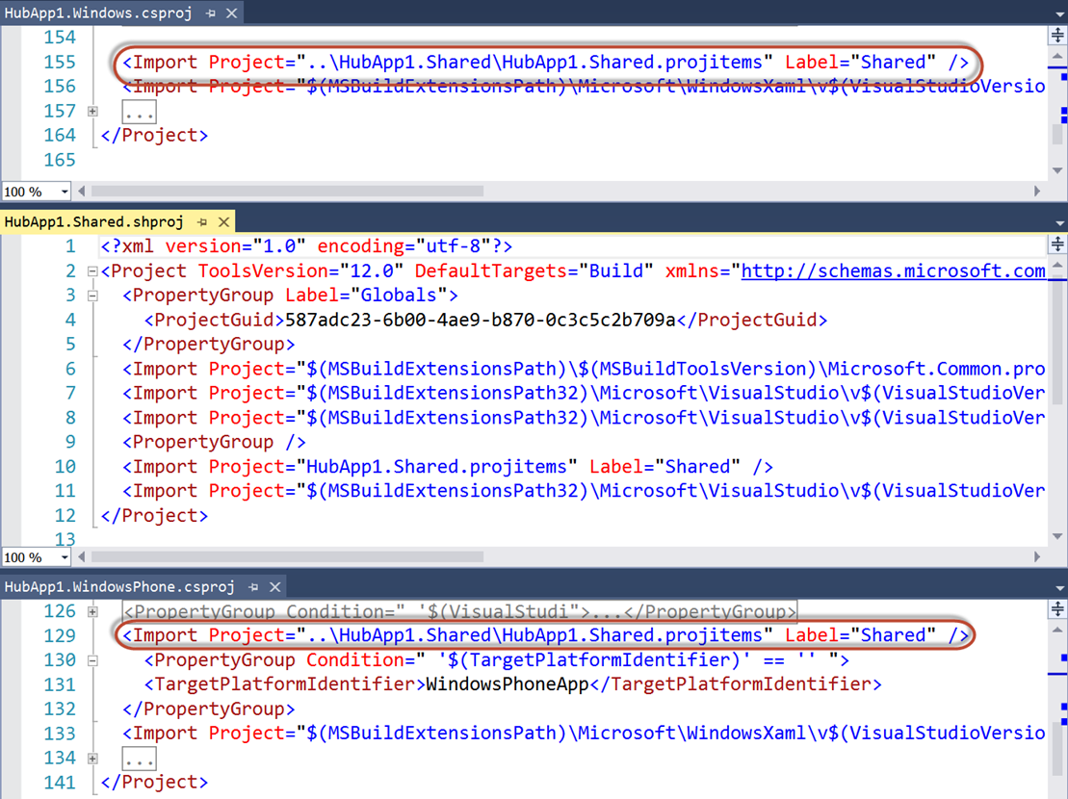
Universal App project template
Shared items imported into other projects
Compile-time constants
#if WINDOWS_APP
#endif
#if WINDOWS_PHONE_APP
#endif

Slide 10
Universal App project template

Slide 11
demo
One-Click Capture to OneNote
Notes:
OneNote Clipper: https://www.onenote.com/Clipper/OneNote
Demos\OneNoteSaveDialog folder: The html page contains two links for the Save Dialog. The first will capture a page from MSDN. The second uses jQuery to dynamically set the page to capture to be the current page. Running the page from http://localhost will cause the capture to omit the picture of the page. This is because the OneNote service cannot access localhost. This is an important distinction that will be discussed later in the module.

Slide 12

© 2012 Microsoft Corporation. All rights reserved. Microsoft, Windows, and other product names are or may be registered trademarks and/or trademarks in the U.S. and/or other countries.
The information herein is for informational purposes only and represents the current view of Microsoft Corporation as of the date of this presentation. Because Microsoft must respond to changing market conditions, it should not be interpreted to be a commitment on the part of Microsoft, and Microsoft cannot guarantee the accuracy of any information provided after the date of this presentation. MICROSOFT MAKES NO WARRANTIES, EXPRESS, IMPLIED OR STATUTORY, AS TO THE INFORMATION IN THIS PRESENTATION.

